Slide 1
A EFFORT TO ENHANCE THE VISION

Slide 2
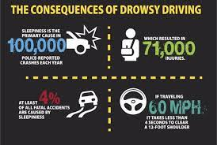
Technical overview
Now a days drowsiness has became a major issue for drivers
Because of that they cannot able to drive properly and it leads to accidents
To overcome this problem we designed a model which detect the drowsiness of a driver and warn him

Slide 3
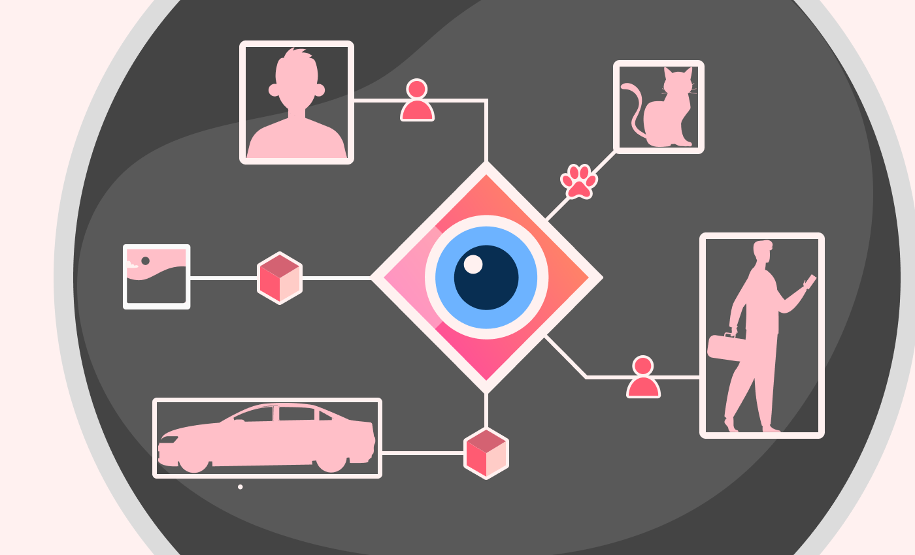
INTRODUCTION TO COMPUTER VISION
Computer vision is a field of artificial intelligence (AI) that enables computers and systems to derive meaningful information from digital images, videos and other visual inputs and take actions or make recommendations based on that information.

Slide 4
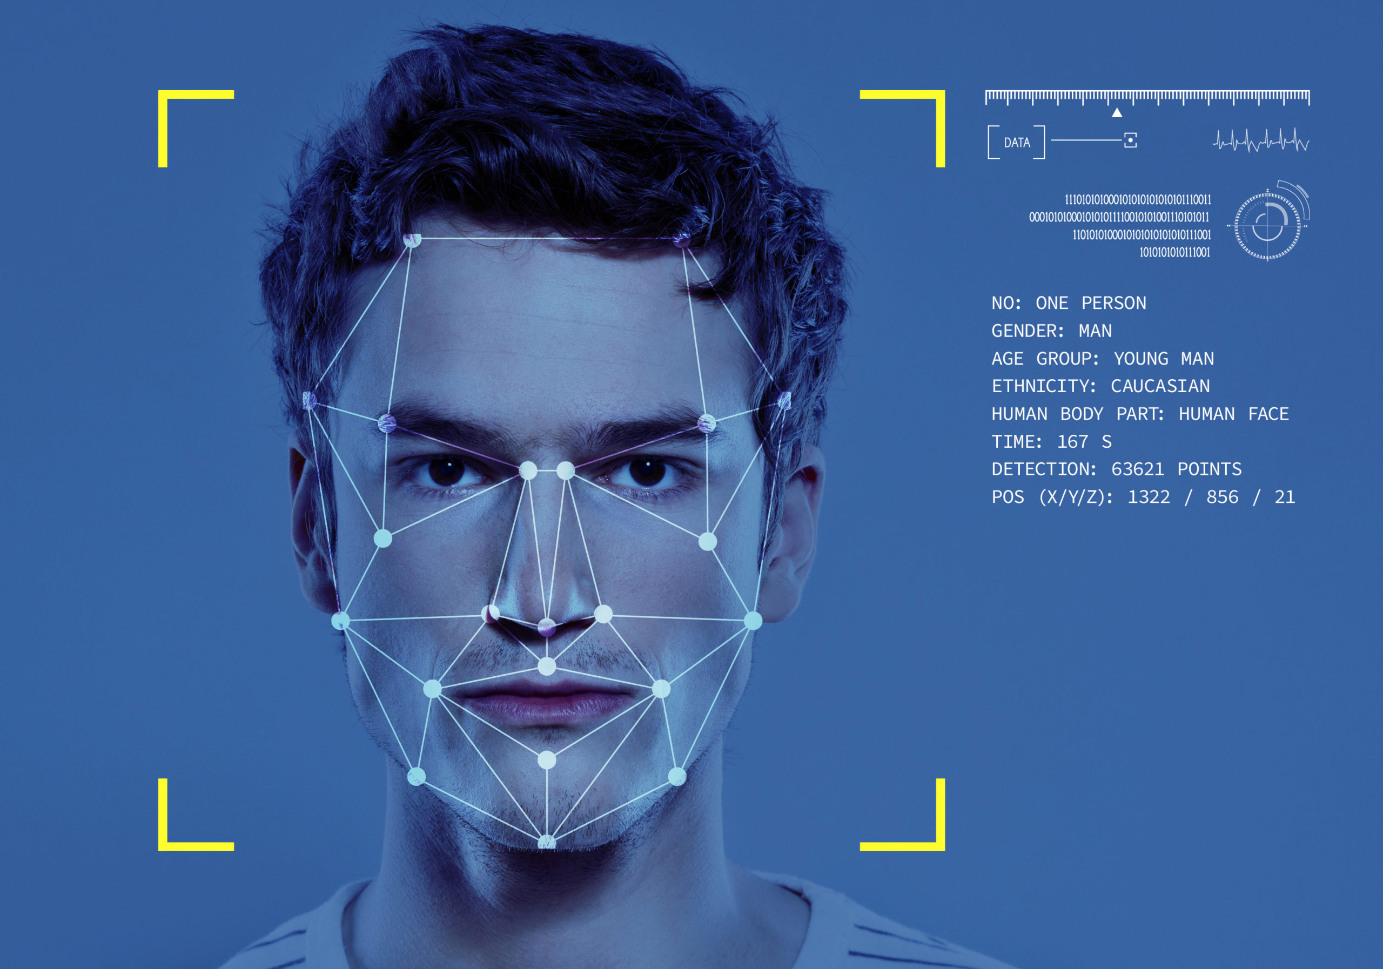
Detection by using computer vision
Object detection is a computer vision technique that works to identify and locate objects within an image or video. Specifically, object detection draws bounding boxes around these detected objects, which allow us to locate where said objects are in (or how they move through) a given scene.
Face detection software detects faces by identifying facial features in a photo or video using machine learning algorithms. It first looks for an eye, and from there it identifies other facial features. It then compares these features to training data to confirm it has detected a face.

Slide 5
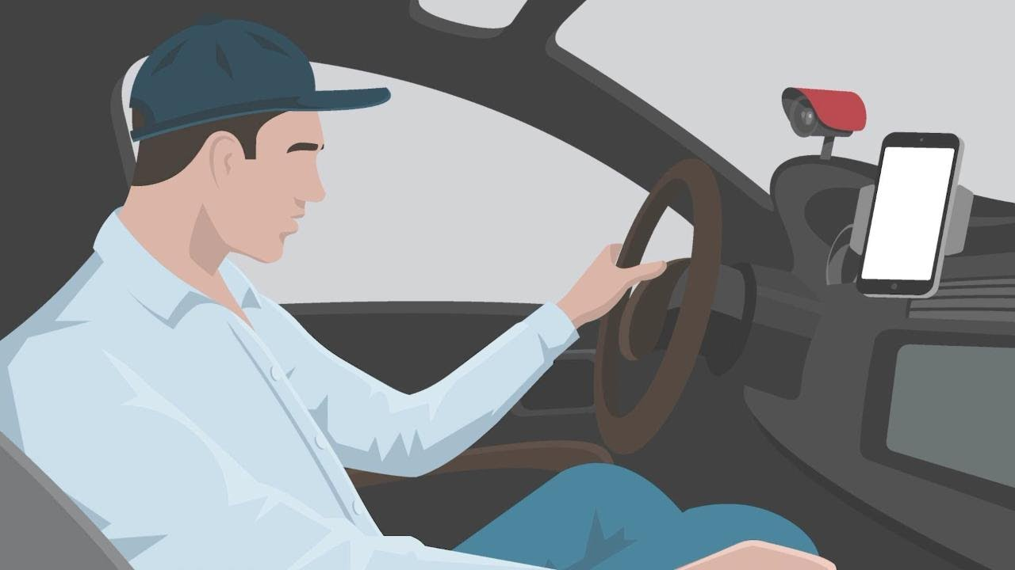
HOW CAN WE DETECT THE DROWSINESS OF A DRIVER?
Driver drowsiness detection systems can use cameras, eye tracking sensors and other hardware to monitor visual cues, where drowsiness can be detected through yawning frequency, eye-blinking frequency, eye-gaze movement, head movement and facial expressions.
Using an infrared camera above the steering wheel, DS DRIVER ATTENTION MONITORING continuously monitors: the eyes for signs of tiredness (blinking); the face and head movements for signs of distraction; and the course steered by the car in its road lane (deviations or steering movements by the driver

Slide 6
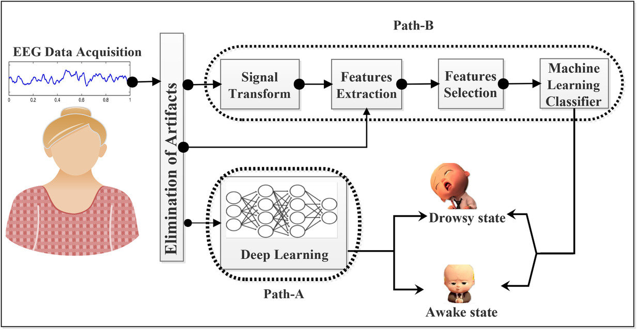
Approach to drowsiness detection
There are two approaches,In an intrusive approach, sensors are used to detect driver drowsiness by placing them on the driver's body, whereas in a non-intrusive approach, a camera is used for drowsiness detection by identifying yawning patterns, eyelid movement and head inclination
Firstly, the video stream is inputted from a camera using OpenCV library. On every sampled video frame, facial landmark detection using dlibs api is being performed. Next,isolating the left and right eye and then we feed the trained model.
For each eye image in frame, the predicted eye state in a queue is stoed, and then used to analyze using Percentage of Eyelid Closed (PERCLOS) value, and then predict if the driver is drowsy or not.

Slide 7

The future and market prospects of computer vision
Future systems will be able to identify suspicious behavior or objects more accurately, enhancing security in public spaces, airports, and even our homes. As tools and platforms become more user-friendly and accessible, we'll see the democratization of computer vision.
The Computer Vision market has three markets. The Speech Recognition market covers the analysis and interpretation of human speech. The Image Recognition market covers the analysis and interpretation of digital images using computer vision, and the Facial Recognition covers the analysis and interpretation of human faces in digital images and/or videos.

